Slide 1
Secure data hiding using steganography
CAPSTONE PROJECT
Presented By : HARSHVARDHAN SINGH
College Name & Department :
University of Petroleum and Energy Studies

Slide 2
OUTLINE
Problem Statement
Technology used
Wow factor
End users
Result
Conclusion
Git-hub Link

Slide 3
Problem Statement
With the rise in digital communication, ensuring the confidentiality of sensitive information has become a major concern. Traditional encryption methods can attract unwanted attention, making data transmission vulnerable to interception. This project focuses on secure data hiding using steganography, where secret messages are embedded within images without noticeable alterations. The goal is to enhance data security by making hidden information imperceptible while maintaining the original image quality.

Slide 4
Technology used
Python for implementing steganography.
OpenCV (cv2) for image processing and pixel modification.
NumPy for efficient numerical and array operations.
OS Module for file handling.
Python IDLE
ASCII Encoding to convert text into numeric values for embedding.

Slide 5
Wow factors
Enhanced Security – Unlike basic encryption, this method hides data inside images, making it invisible and reducing the chances of detection.
Lossless Steganography – Uses PNG format to prevent compression artifacts, ensuring hidden data remains intact.
Automated Message Length Handling – No need for manual input; the algorithm stores and retrieves message length automatically, preventing corruption.
Stealth Communication – The modified image looks identical to the original, making it undetectable to unauthorized users.
Lightweight & Efficient – Uses optimized pixel traversal for fast encryption and decryption without compromising image quality.

Slide 6
End users
Government & Defense – Secure transmission of confidential data.
Journalists & Whistleblowers – Protect sensitive communication.
Businesses – Safeguard trade secrets and financial data.
Cybersecurity Professionals – Implement covert data security measures.
Individuals & Activists – Ensure private communication in restricted environments.
Law Enforcement & Forensic Experts – Secure evidence storage and transfer.

Slide 7
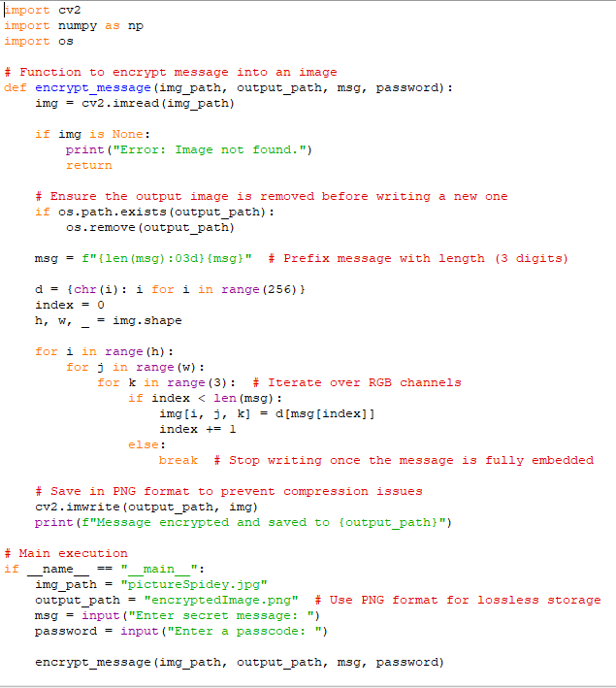
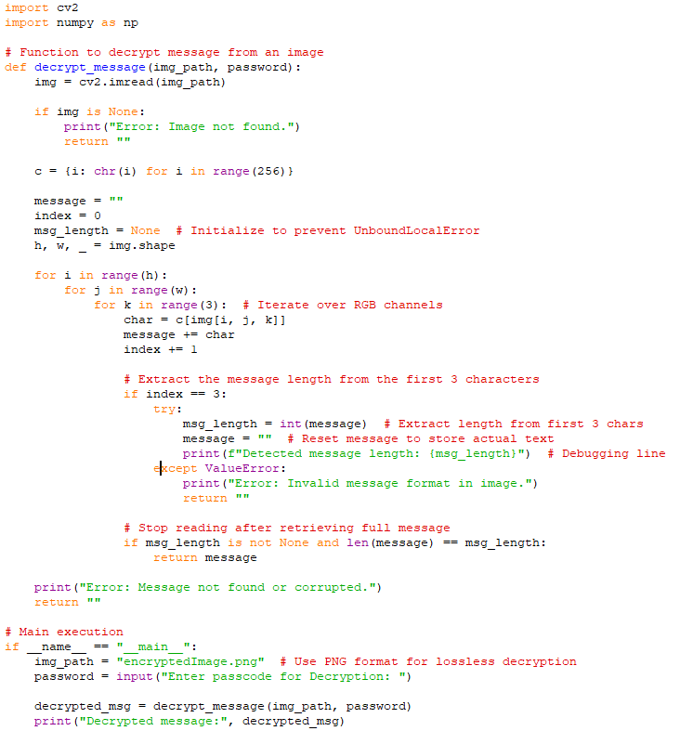

Results

Slide 8
Conclusion
This project successfully demonstrates secure data hiding using steganography, providing an effective method for concealing sensitive information within images. By embedding messages in a way that is imperceptible to the human eye, it enhances security while ensuring confidentiality. Unlike traditional encryption, which may attract attention, this approach allows covert communication without raising suspicion. The use of lossless image formats, automated message handling, and dual-layer security makes this method both efficient and reliable. Overall, this project offers a practical and innovative solution for secure, undetectable data transmission.

Slide 9
GitHub Link
https://github.com/101Hades101/Secure-data-hiding-using-steganography.git

Slide 10
THANK YOU

